Slide 1
Transcranial magnetic stimulation (TMS)
Neuromodulation Working Group Meeting
1st Dec 2017
Katherine Naish

Slide 2
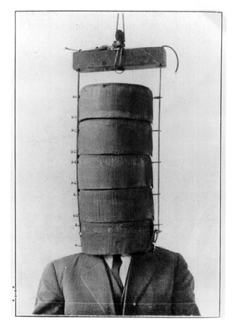
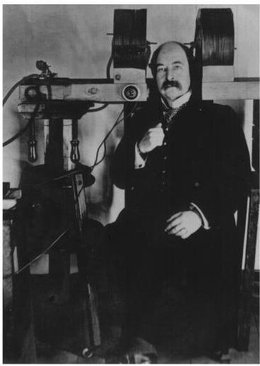
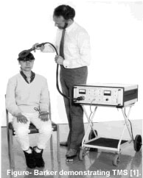
History
First use of magnetic fields to produce visual phosphenes in early 1900s
Anthony Barker (1985): first use of modern TMS machine
Thompson, 1910
Magnussen & Stevens, 1911

Slide 3
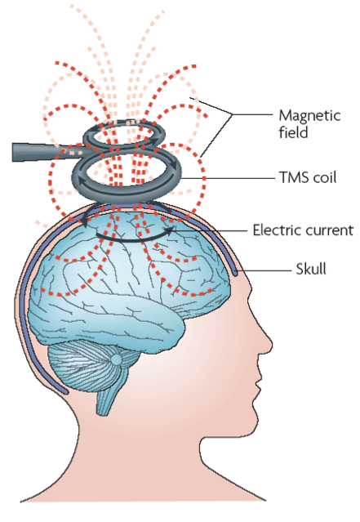
Mechanism of action
Faraday’s principle of electromagnetic induction: rapid variation in an electrical current can induce a magnetic field
Large magnetic field produced for ~1ms
Rapid change induces electrical current in area under coil, activating neurons

Slide 4
Types of TMS
Single-pulse TMS (spTMS)
Paired-pulse TMS (ppTMS)
Repetitive TMS (rTMS)

Slide 5
Uses of TMS
Single-pulse and paired-pulse used primarily to study the motor system (effects also seen for visual cortex)
Repetitive used to induce longer-lasting changes (therapeutic use) or for disruption of function

Slide 6
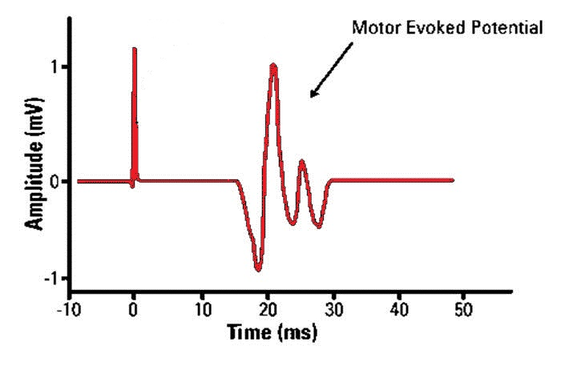
Measure of corticospinal excitability
(MEP)
Size of muscle response indicates level of motor activity

Slide 7
Disruption of function
https://www.youtube.com/watch?v=gp8KnAHkwdo

Slide 8
Repetitive TMS (rTMS)
Repeated pulses over period of seconds or minutes; usually over multiple sessions
Effects last longer than period of stimulation
Frequencies above 1Hz usually increase cortical excitability; 1Hz or lower usually decrease excitability

Slide 9
Repetitive TMS (rTMS)
Potential mechanism: long term potentiation (LTP) or depression (LTD)
Pharmacological evidence that after-effects involve glutamatergic NMDA receptor
Compensatory changes in brain activity

Slide 10
Important parameters
Stimulation intensity
Pulse frequency
Inter-pulse intervals (e.g., for ppTMS)
Duration of stimulation

Slide 11
Repetitive TMS (rTMS)
Therapeutic uses of increasing/decreasing function in certain areas
First therapeutic use for depression, on basis that depression caused by dysfunction in left PFC
More recently, rTMS used to reduce cravings in substance abuse disorders

Slide 12
Repetitive TMS (rTMS)
Considerable within- and between-subject variability
Differences in brain anatomy
Level of attention
Hormonal changes
Different effects at different stages of menstrual cycle in women; differences between morning and evening effects

