Slide 1
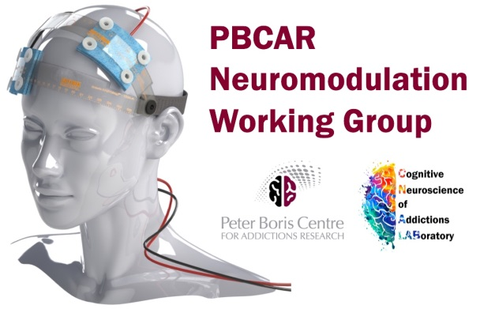
TES Safety and Tolerability
Dr. Michael Amlung
12/8/2017

Slide 2
Disclaimer
The content presented in these slides is meant to provide an overview of current best practices and guidelines for safety of TES. These recommendations are not intended to be exhaustive and may become outdated as additional research on safety is published.
The author does not guarantee that this content is up-to-date if these slides are accessed at a later date.
Always consult current safety guidelines before initiating any TES research or clinical project.

Slide 3
Topics
Is TES non-invasive?
Key terminology & definitions
Adverse effects of TES
Monitoring adverse effects after TES
Contraindications for TES
Recommendations & conclusions

Slide 4
Is TES Non-Invasive?

Slide 5
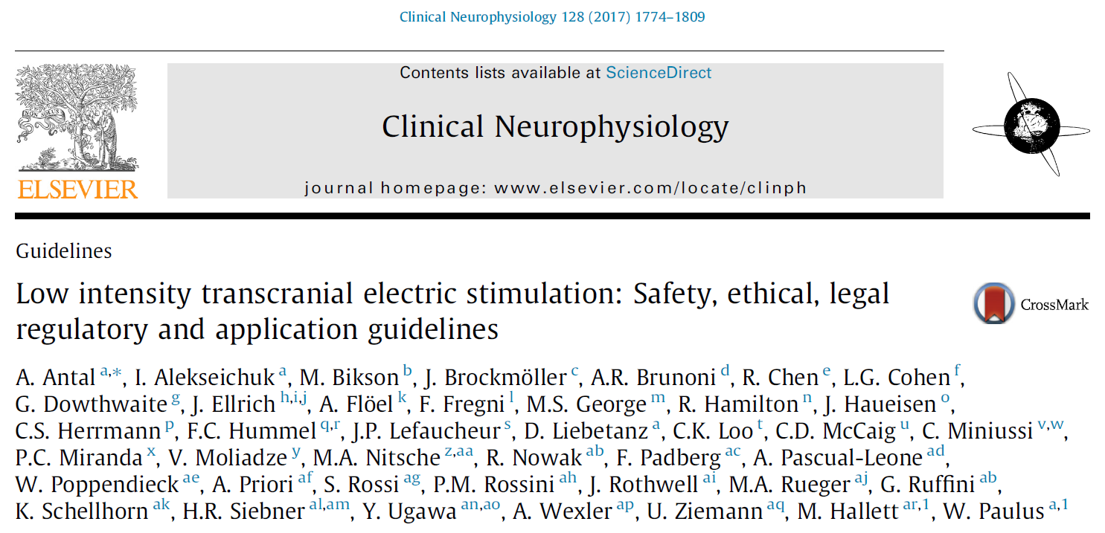
Consensus Group Paper

Slide 6
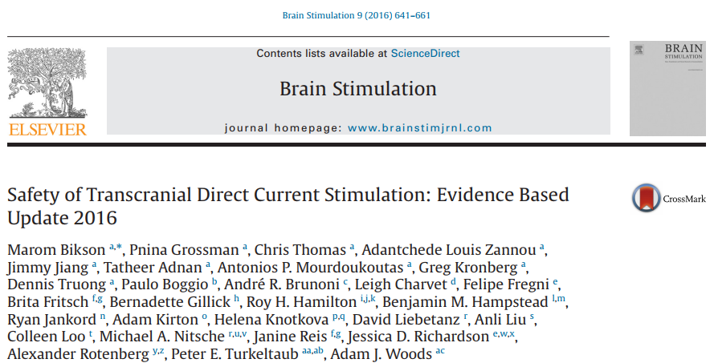
Current Comprehensive Review

Slide 7
Key Terminology & Definitions

Slide 8
Key Terminology & Definitions
Tolerability
Presence of uncomfortable and unintended effects, which do not induce structural or functional damage
Safety
Refers to occurrence of damaging effects
Can only be considered in relative terms
Source: Brunoni Chapter 12 Transcranial Direct Current Stimulation in Neuropsychiatric Disorders

Slide 9
Key Terminology & Definitions
Side Effects vs. Adverse Effects
Side effect and adverse effects often used interchangeably, but this is problematic
According to Antal et al (2017), Side effects are consequences that are different than the intended effect, and might be good or bad (beneficial or adverse).
Side effect example: Improvement in memory by an intervention for depression
Adverse events are, by definition, always bad.

Slide 10
Key Terminology & Definitions
Adverse Effects
Food and Drug Administration (FDA): Any undesirable experience associated with the use of a medical product (or intervention) in a patient or participant
May or may not be causally related to the intervention
Mild AE: Mild symptoms for which no medical treatment is necessary (skin redness, tingling)
Moderate AE: Need of local or noninvasive treatment (application of cream after a skin burn)
Serious AE: Severe or medically significant but not immediately life-threatening events, include the inpatient hospitalization
Life-threatening SAEs: Any event that is life threatening or resulting in death.

Slide 11
Key Terminology & Definitions
Adverse Reaction (Health Canada)
Undesirable effects to health products, including drugs, medical devices, and natural health products. Reactions may occur under normal use conditions of the product.
Reactions may be evident within minutes or years after exposure to the product and may range from minor reactions like a skin rash to serious and life-threatening events such as a heart attack or liver damage.
Governed by the Food and Drug Act and Regulations

Slide 12
Key Terminology & Definitions
Good Clinical Practice (GCP)
Adverse Event (AE)
Any untoward medical occurrence in a patient or clinical investigation subject administered a pharmaceutical product and which does not necessarily have a causal relationship with this treatment. An adverse event (AE) can therefore be any unfavourable and unintended sign (including an abnormal laboratory finding), symptom, or disease temporally associated with the use of a medicinal (investigational) product, whether or not related to the medicinal (investigational) product.

Slide 13
Key Terminology & Definitions
Good Clinical Practice (GCP)
Serious Adverse Event (SAE)
Any untoward medical occurrence that at any dose: results in death, is life-threatening, requires inpatient hospitalization or prolongation of existing hospitalization, results in persistent or significant disability/incapacity, or is a congenital anomaly/birth defect

Slide 14
Key Terminology & Definitions
According to European Medical Device Directive
“Safe” is a condition where all risks are accepted risks
However, all stimulation protocols carry a certain degree of risk and could cause problems in specific circumstances
Current approach is to estimate potential of a protocol becoming a hazard, or a potential for an adverse event
Risk is a measure of the combination of the hazard, the likelihood of occurrence of the AE and the severity.
Risk Benefit Ratio: Overall ratio of all potential benefits of a procedure divided by all the adverse reactions.
Antal et al 2017

Slide 15
Key Terminology & Definitions
Direct benefit, high risk: Diagnostic or therapeutic primary objective, direct clinical benefit for participant. Acceptable risks may be higher. Generally patients only.
Indirect benefit, moderate risk: Little or no expectation of clinical benefit. Development of treatments, safety, understanding diseases. Generally patients only (unless healthy controls are included as a comparison)
Indirect benefit, low risk: Important data on brain physiology, general pathology, or safety, but no immediate clinical relevance
High benefit, low risk: Important data on cognition/brain function, immediate relevance for cognitive/motor improvement (neuroenhancement)
Antal et al 2017

Slide 16
Key Terminology & Definitions
Risk is differentiated from burden: a procedure may be burdensome (e.g., produce much discomfort) but still be considered safe (e.g., not having any relevant risk for permanent damage)
Antal et al 2017

Slide 17
Adverse Effects of TES

Slide 18
Start with the Take Home Message
“Within the standard parameters of use… the evidence indicates that tDCS is a well-tolerated technique, with few, mild side effects”
“Although tDCS is considered to be ‘safe’, as the tDCS device is limited to delivering a low-dose current which has effects on cortical excitability, and no major or serious adverse effects have been reported, such findings do not imply that tDCS is ‘universally safe’ and should therefore be used without limits or controls”
Brunoni et al. Chapter 12. p 348

Slide 19
Tolerability: Common Adverse Effects
Poreisz et al. 2007 – Data from 567 tDCS sessions
Mild tingling sensation (71%)
Fatigue (35%)
Itching (30%)
Headache (12%)
Nausea (3%)
Insomnia (<1%)

Slide 20
Tolerability: Common Adverse Effects
Systematic reviews, meta-analyses, and other studies
Poreisz et al. 2007 – Data from 567 tDCS sessions
Mild tingling sensation (71%)
Fatigue (35%)
Itching (30%)
Headache (12%)
Nausea (3%)
Insomnia (<1%)
All effects were mild, short-lived, and well-tolerated. Rate was mostly similar for active/sham conditions

Slide 21
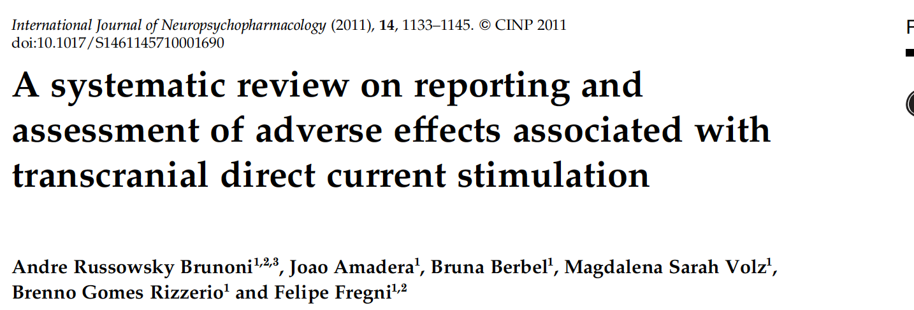
Common Adverse Effects
Systematic reviews, meta-analyses, and other studies
Brunoni et al. 2011 – Meta-analysis of all tDCS clinical studies from 1998 to 2010.
209 studies, nearly 4000 subjects
56% monitored affects, 63% reported at least one averse effect

Slide 22
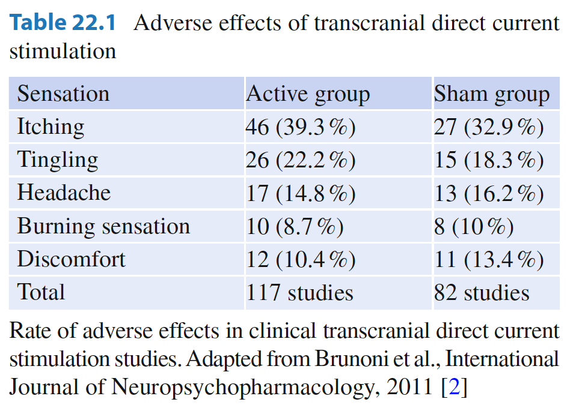
Common Adverse Effects
Systematic reviews, meta-analyses, and other studies
Brunoni et al. 2011 – Meta-analysis of all tDCS clinical studies from 1998 to 2010.

Slide 23
Common Adverse Effects
Skin Reddening: tDCS-induced erythema
Intensity varies in patients; most only experience mild redness, while others might have more intense reddening
Cause is not clear, but likely partially due to increased blood floor in dermal vessels; release of neuropeptides, vasoactive substances
More prominent over anode than cathode
Lasts less than 18-24 min
Less intense in darker skin color
Not influenced by gender, age, or smoking status

Slide 24
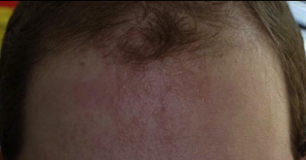
Common Adverse Effects
Contact dermatitis:

Slide 25
Serious Adverse Effects
“To date, the use of conventional tDCS protocols in human trials (≤40 min, ≤4 mA) has not produced any reports of a Serious Adverse Effect or irreversible injury across over 33,200 sessions and 1,000 subjects with repeated sessions.
This includes a wide variety of subjects, including persons from potentially vulnerable populations.”
Source: Bikson et al. (2016). Safety of transcranial direct current stimulation: Evidence based update 2016. Brain Stimulation

Slide 26
Serious Adverse Effects
Includes induction of seizure, stroke, cardiac arrest, etc.
One report seizure in a 4-year-old with history of seizure/spasm
Screen for history of seizure, epilepsy, etc.
Safety studies indicate:
tDCS does not change heart rate variability
Does not increase level of brain enzymes linked to neuronal death
Does not qualitatively alter EEG activity

Slide 27
Serious Adverse Effects
Skin Lesions/Burns
Palm et al. 2008 reported 5 cases of skin lesions after 5 days of 2mA stimulation with tap water soaked sponges
Frank et al 2010 reported 3 cases of skin lesions under anode 1.5ma, tap water soaked
Rodriguez et al 2014 reported 4 cases of skin burn under cathode, saline soaked

Slide 28
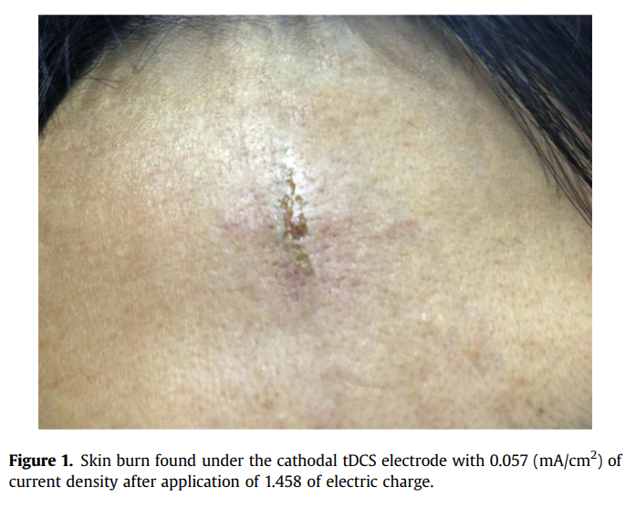
Serious Adverse Effects
Skin Lesions/Burns
Wang et al. 2014 Brain Stimulation Letter to Editor.
5x7cm electrode, saline soaked, cathode secured by elastic strap, 2mA stimulation for 26 min.
Subject retrospectively reported a burning/stinging sensation during tDCS
“We believe that this skin burn resulted from extensive skin heating produced by inhomogeneous electric current which resulted in higher temperatures in a local area, the middle area under the electrode in the forehead region.”
Conclusion → Use caps, not straps! And immediately report any discomfort

Slide 29
Serious Adverse Effects
Skin Lesions/Burns
Brunoni chapter conclusion: Skin damage caused by tDCS has been occasionally reported. Unclear whether it is more common under anode or cathode. More common with tap water soaked sponges.
Loo et al. 2011 suggest some precautions
Screening for skin disease
Checking skin where electrode is placed before each session
Avoid abrasion of the skin
Ask patients to report any pain during tDCS (but not foolproof → Palm et al 2014)

Slide 30
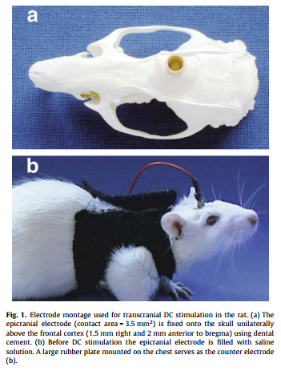
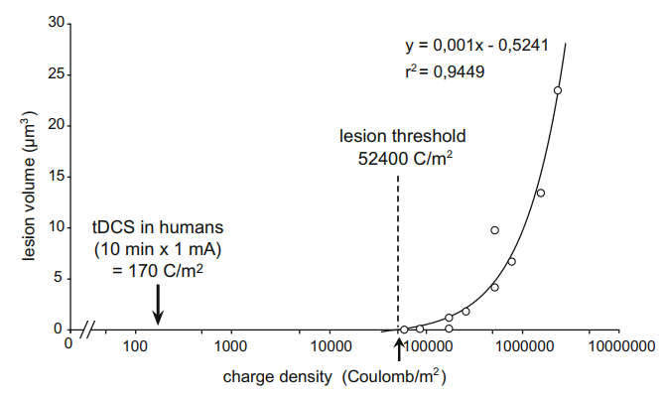
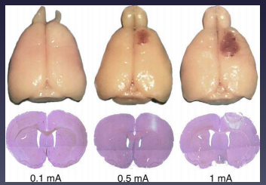
Serious Adverse Effects
Neuronal Damage / Lesions
Animal study by Liebetanz et al (2009)

Slide 31
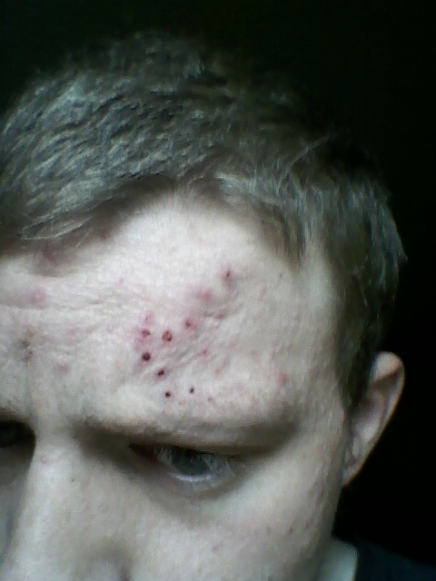
DIY TDCS
Bikson et al (2013) quote on DIY:
“Controlled investigation of tDCS for treating neuropsychiatric disorders or for neurorehabilitation should not be confused with improvised devices...
Experimentation outside established and tested norms may put subjects at risk…
Meddling with the tDCS dose is potentially as dangerous as tampering with a drug’s chemical composition.”

Slide 32
Special Populations
Children
See section in Bikson et al (2016) Brain Stimulation review
See section in Antal et al. (2017) Clinical Neurophysiology consensus paper
“In trials involving children, at least 2800 sessions have been applied across nearly 500 subjects. No serious adverse effects have been reported. tDCS has been investigated in children with a variety of diagnoses including cerebral palsy, stroke, encephalitis, epilepsy, schizophrenia and attention-deficit hyperactivity disorder.” Bikson 2016
Possible increased brain current density at same voltage (smaller average head size)
“Combining this emerging pediatric evidence with the larger animal and adult experience suggests tDCS within the same ranges of dosing and duration can be considered minimal risk, based on current evidence, in school-aged children.” Bikson 2016

Slide 33
Special Populations
Aging
See section in Bikson et al (2016) Brain Stimulation review
Mood Disorder
Induction of (hypo)manic episodes.
There are four stand-alone case reports in literature and some reports in randomized clinical trials of mania or hypomania induction after tDCS treatment.
Difficult to infer whether tDCS caused symptoms or if they were a part of natural history of the disease
Bikson et al (2016) “emphasize a lack of convincing evidence that tDCS increases risk of manic switch. In trials for depression, greater than 4160 sessions have been applied across more than 430 subjects without a documented Serious Adverse Effect.”

Slide 34
Monitoring Adverse Effects
Consensus group provided a questionnaire for systematically monitoring AEs during stimulation protocols
Available here: http://www.neurologie.uni-goettingen.de/downloads.html

Slide 35
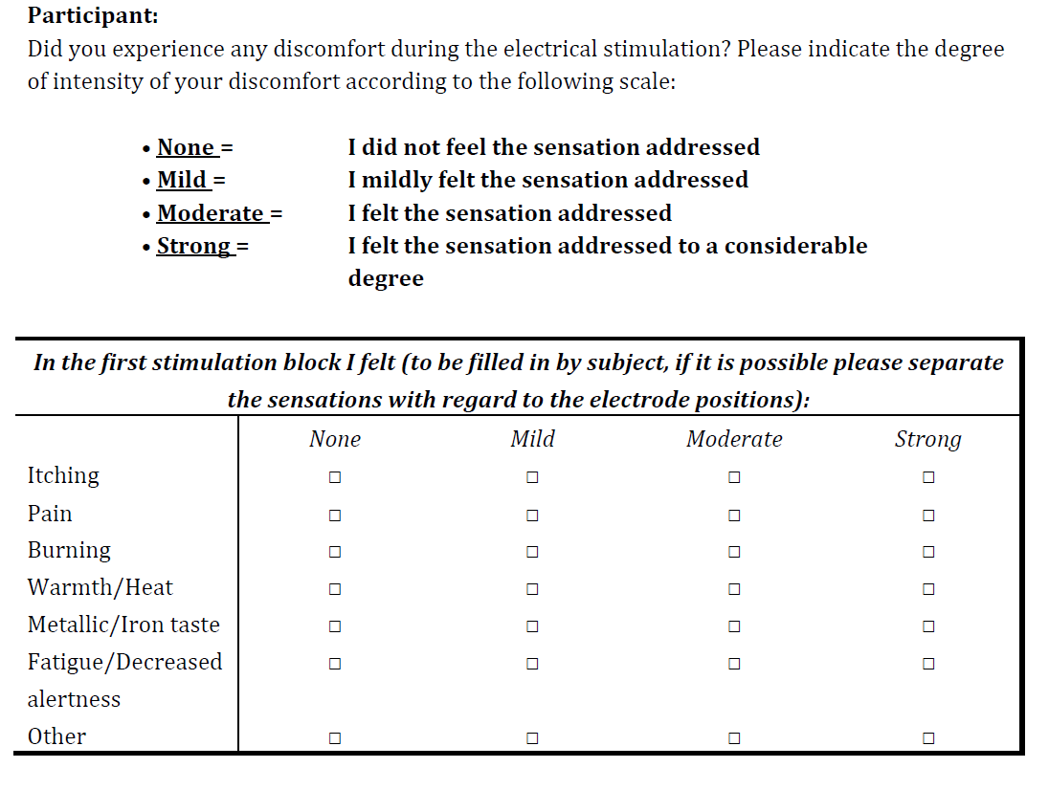
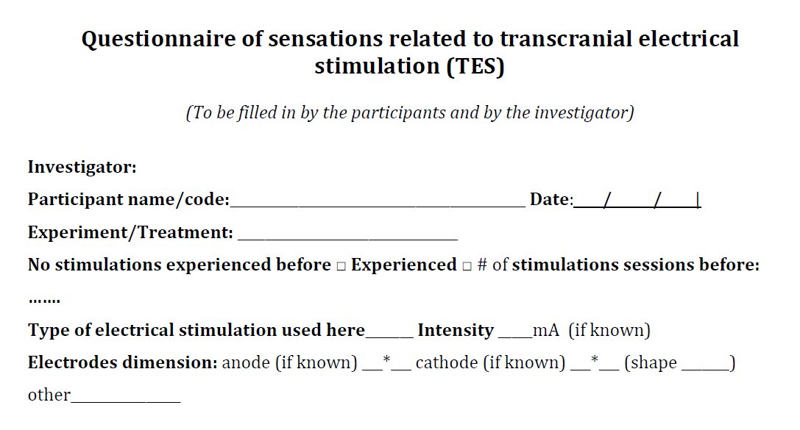
Monitoring Adverse Effects
Consensus group provides a questionnaire for systematically monitoring AEs during stimulation protocols
Available here: http://www.neurologie.uni-goettingen.de/downloads.html

Slide 36
Contraindications for TES
Not all of these are definite rule-outs: *Do not rely on this list*
Do not place electrodes directly above areas of impaired skin
No chronic skin diseases
No implanted metallic plates or devices, neurostimulators, pacemakers, pumps, etc.
No history of previous neurosurgical procedures, neurologic malformations, or brain neoplasias
Head trauma / loss of consciousness / skull defects
Pregnancy
Seizures/epilepsy
Fainting spells, syncope
Previous adverse reactions / effects to TES or TMS
Medications?
Caffeine? Alcohol?

Slide 37
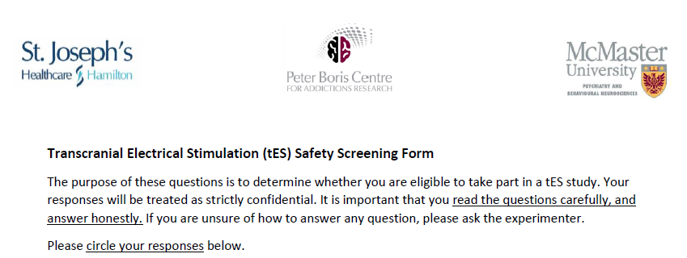
Screening Participants

Slide 38
Bottom Line
Always screen carefully
Always inspect the equipment prior to each use
Old/dried sponges, broken electrodes, frayed wires, rusting, device charged, appropriate blinding in place, etc.
Always monitor for AEs during experiment and also consider contacting for follow-up monitoring
Always document and report any AEs
Always operate within standard protocols and procedures
Have emergency procedures in place
Training is key!

Slide 39
Comment on Standardizing Protocols
Standard system for multidimensional parameter space for the experiment. Clearly defined protocols with electrode type, positions, current type, intensity, duration, sequencing, spacing, etc.
Use checklists provided by the Consensus Group (Antal et al. 2017)

Slide 40
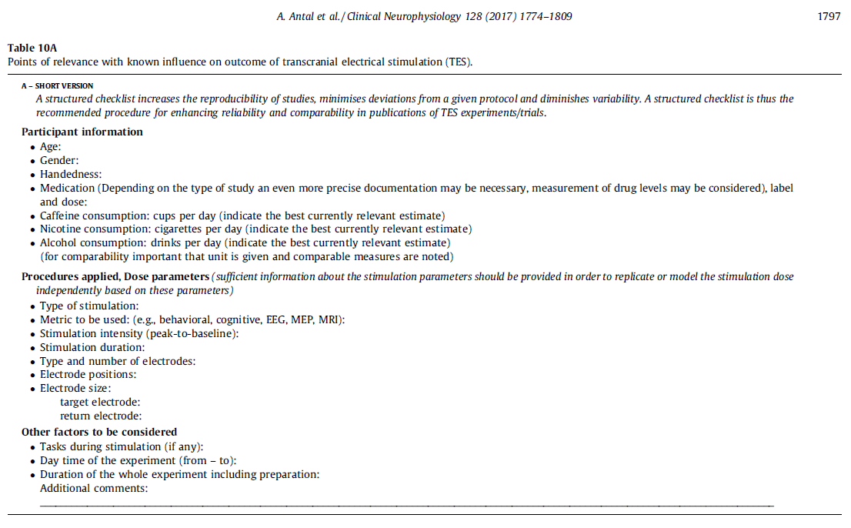

Slide 41
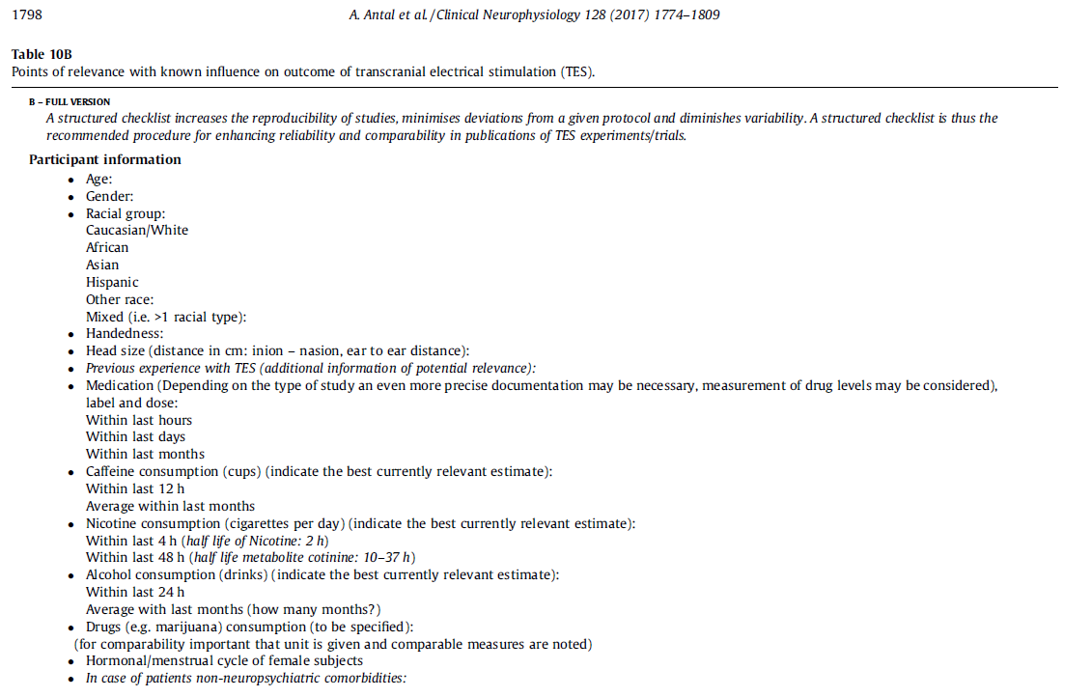

Slide 42
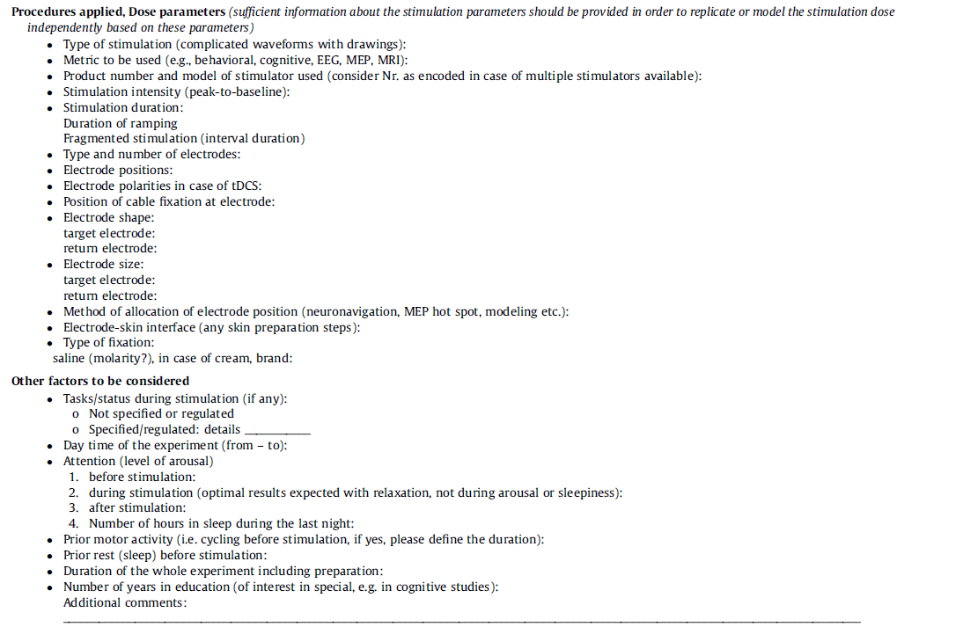

Slide 43
Return to the Take Home Message
“Within the standard parameters of use… the evidence indicates that tDCS is a well-tolerated technique, with few, mild side effects”
“Although tDCS is considered to be ‘safe’, as the tDCS device is limited to delivering a low-dose current which has effects on cortical excitability, and no major or serious adverse effects have been reported, such findings do not imply that tDCS is ‘universally safe’ and should therefore be used without limits or controls”
Brunoni et al. Chapter 12. p 348

